Slide 1

ZERO LECTURE
Name of Course : Introduction to Web Technology
Code : BCECCE3101

Slide 2

OBJECTIVES
About Me
About the Course
Relevance of the Course
Course Objectives
Introductory details about various Units
Prerequisites
Recommended Study Materials
Examination System

Slide 3
SELF INTRODUCTION
Name : Gaurav Kumar
Designation : Assistant Professor
E-mail Id : gaurav.kumar1@poornima.edu.in
Qualification : M.C.A, PHD (Pursuing)
Experience : 1 year

Slide 4
INTRODUCTION TO THE COURSE
This course provides a foundational understanding of web development, covering the evolution of the internet, core web technologies like HTML, CSS, and XML, and the process of building responsive and structured web pages. Students will explore both front-end and basic back-end concepts, enabling them to design, develop, and deploy simple yet functional websites. The course blends theoretical concepts with practical implementation, preparing learners for real-world web development tasks.

Slide 5
RELEVANCE OF THE COURSE
Relevance to Branch: This course is essential for understanding core web technologies and serves as a foundational stepping stone for pursuing careers in software development, web design, and various IT roles in the tech industry.
Relevance to Society & Industry: Empowers creation of accessible, interactive websites and web apps that drive digital communication, e-commerce, education, and services.
Relevance to Self: Builds personal skills in designing and developing web applications, encourages creativity, and enhances problem-solving abilities.

Slide 6
RELEVANCE OF THE COURSE
Connection with Previous & Next Year: Builds on basic programming skills from previous year; prepares for advanced courses like web frameworks, backend development, and full-stack projects in later semesters.
Potential for Career: There is a consistently high demand for skilled web developers across all industries—from tech and education to healthcare and e-commerce. This course lays a strong foundation for a variety of in-demand roles such as front-end developer, UI/UX designer, full-stack engineer, and web application developer, opening the door to numerous career opportunities in the digital economy

Slide 7


Slide 8
IN-DEMAND JOB ROLES
Front-End Developer
Builds user interfaces using HTML, CSS, and JavaScript.
UI/UX Designer Focuses on user experience, wireframing, and design principles.
Full-Stack Developer Works on both front-end and back-end of web applications.
Web Designer / Web Administrator Designs, maintains, and updates websites.
Freelance Web Developer Offers services to clients for portfolio sites, blogs, and business pages.
Knowledge of web basics is a gateway to learning React, Angular, Node.js, etc.

Slide 9
COURSE OBJECTIVES
By the end of this course, students will be able to:
Understand the fundamentals of the Internet and Web Technologies
Create well-structured web pages using HTML and style them using CSS
Implement modern features using HTML5 and CSS3
Work with XML for structured data representation
Set up and manage a basic website on a server

Slide 10
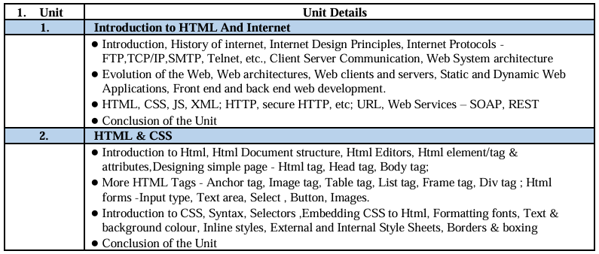
SYLLABUS

Slide 11
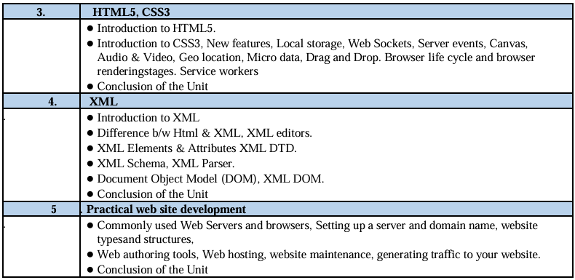
SYLLABUS

Slide 12
Prerequisites
Basic computer literacy and familiarity with operating systems
Understanding of fundamental programming concepts (variables, loops, conditions)
Prior exposure to any programming language (e.g., C, C++, Python) is helpful
Ability to navigate and use a web browser effectively
Logical thinking and problem-solving skills

Slide 13
Books / Websites
Books:
HTML and CSS: Design and Build Websites by Jon Duckett
Learning Web Design by Jennifer Niederst Robbins
Web Technologies by Uttam K. Roy
Websites:
w3schools.com – Tutorials and examples
freecodecamp.org – Interactive learning

Slide 14
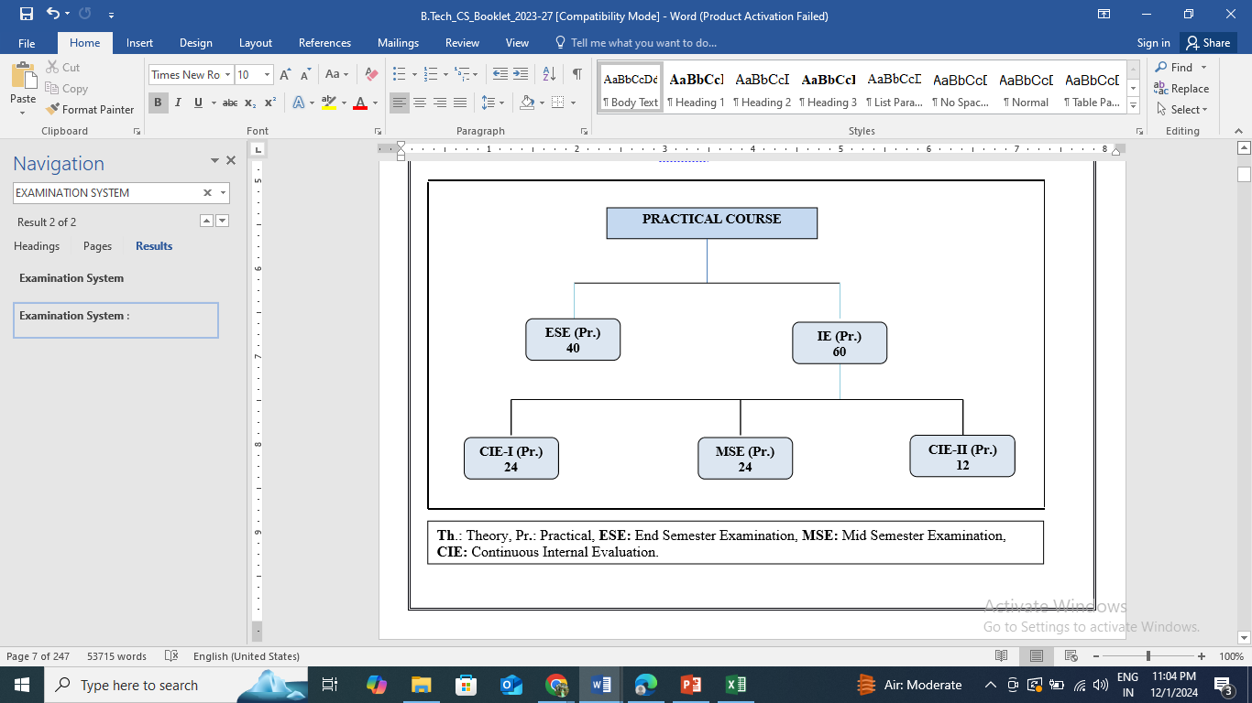
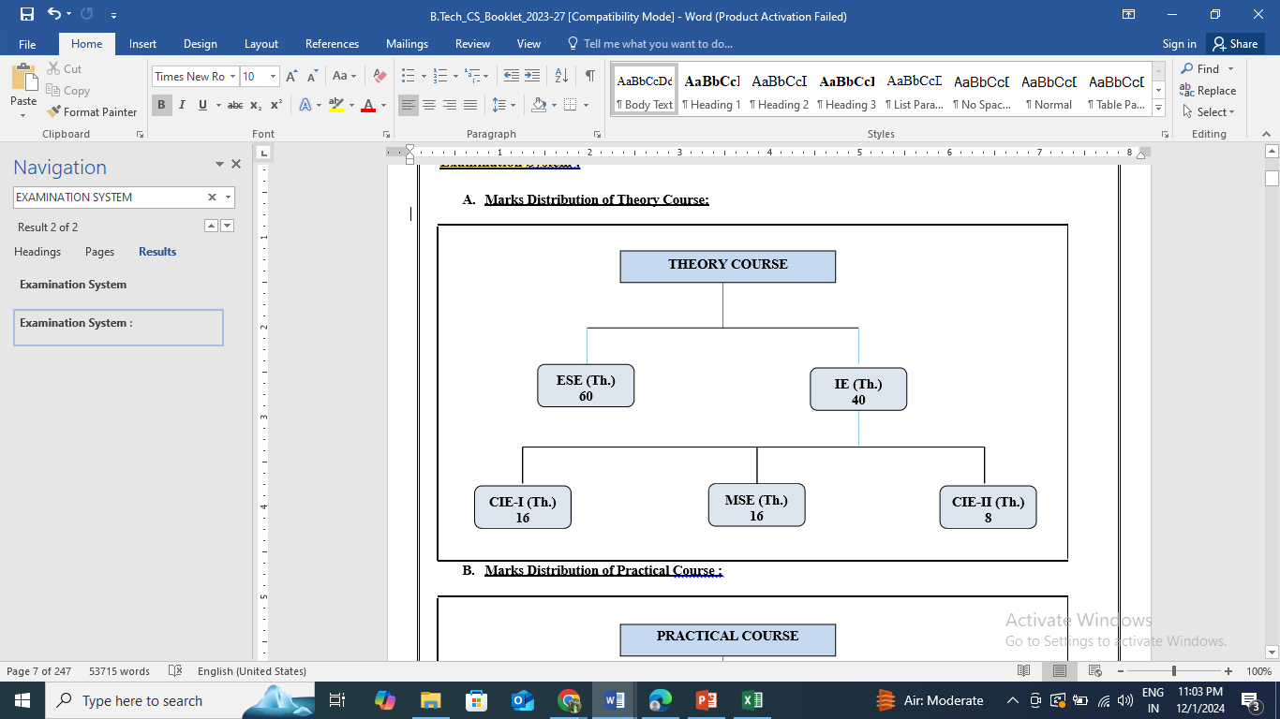
Examination System
Marks Distribution of practical Course:
Marks Distribution of Theory Course:

Slide 15
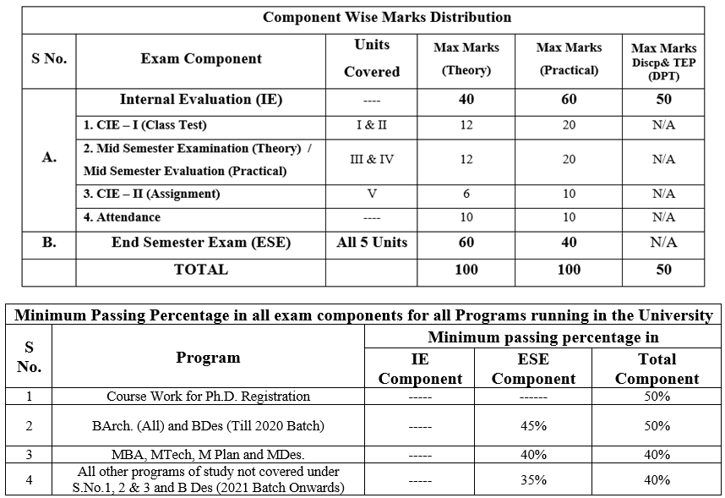
16
24
16
24
8
12

Slide 16
Thank You !

